Slide 1

Employee Attendance Analysis
DE & A – BATCH 246
RLL PROJECT
PRESENTED BY : K.BHANUCHARAN
EMP ID : 2620774

Slide 2
AGENDA
Scenario
Activities
Components
Talend Pipeline
Output

Slide 3
SCENARIO:
Clean and analyze employee attendance data to calculate absenteeism.
Datasets:
Attendance Logs (attendance.csv):
output :
EmployeeID | Date | Status
E001 | 2024-11-01 | Present
E002 | 2024-11-01 | Absent
E001 | 2024-11-02 | Present
EmployeeID | TotalAbsentDays
E001 | 0
E002 | 1

Slide 4
ACTIVITIES:
Read attendance logs from multiple months.
Combine data into a single flow.
Calculate total absenteeism per employee.

Slide 5
COMPONENTS:
tfileList
tFileInputDelimited
tUnite
tFilterRow
tMap
tAggregateRow
tFileOutputDelimited
tLogRow

Slide 6
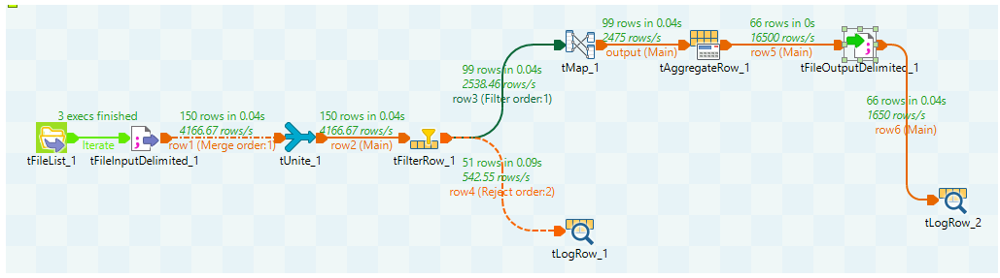
TALEND PIPELINE

Slide 7
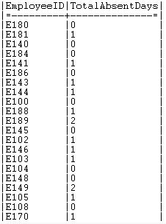
OUTPUT

Slide 8
Thank you

